Slide 1

DISTANCE VECTOR ROUTING PROTOCOL SIMULATOR
Computer Networks Course Project
Name: [Mohammad Farhadul Haque Fuad]
ID Number: [2102067]
University: [Patuakhali Science and Technology University]
Date: [25-11-2025]
A Python-based educational tool for understanding distributed routing algorithms

Slide 2



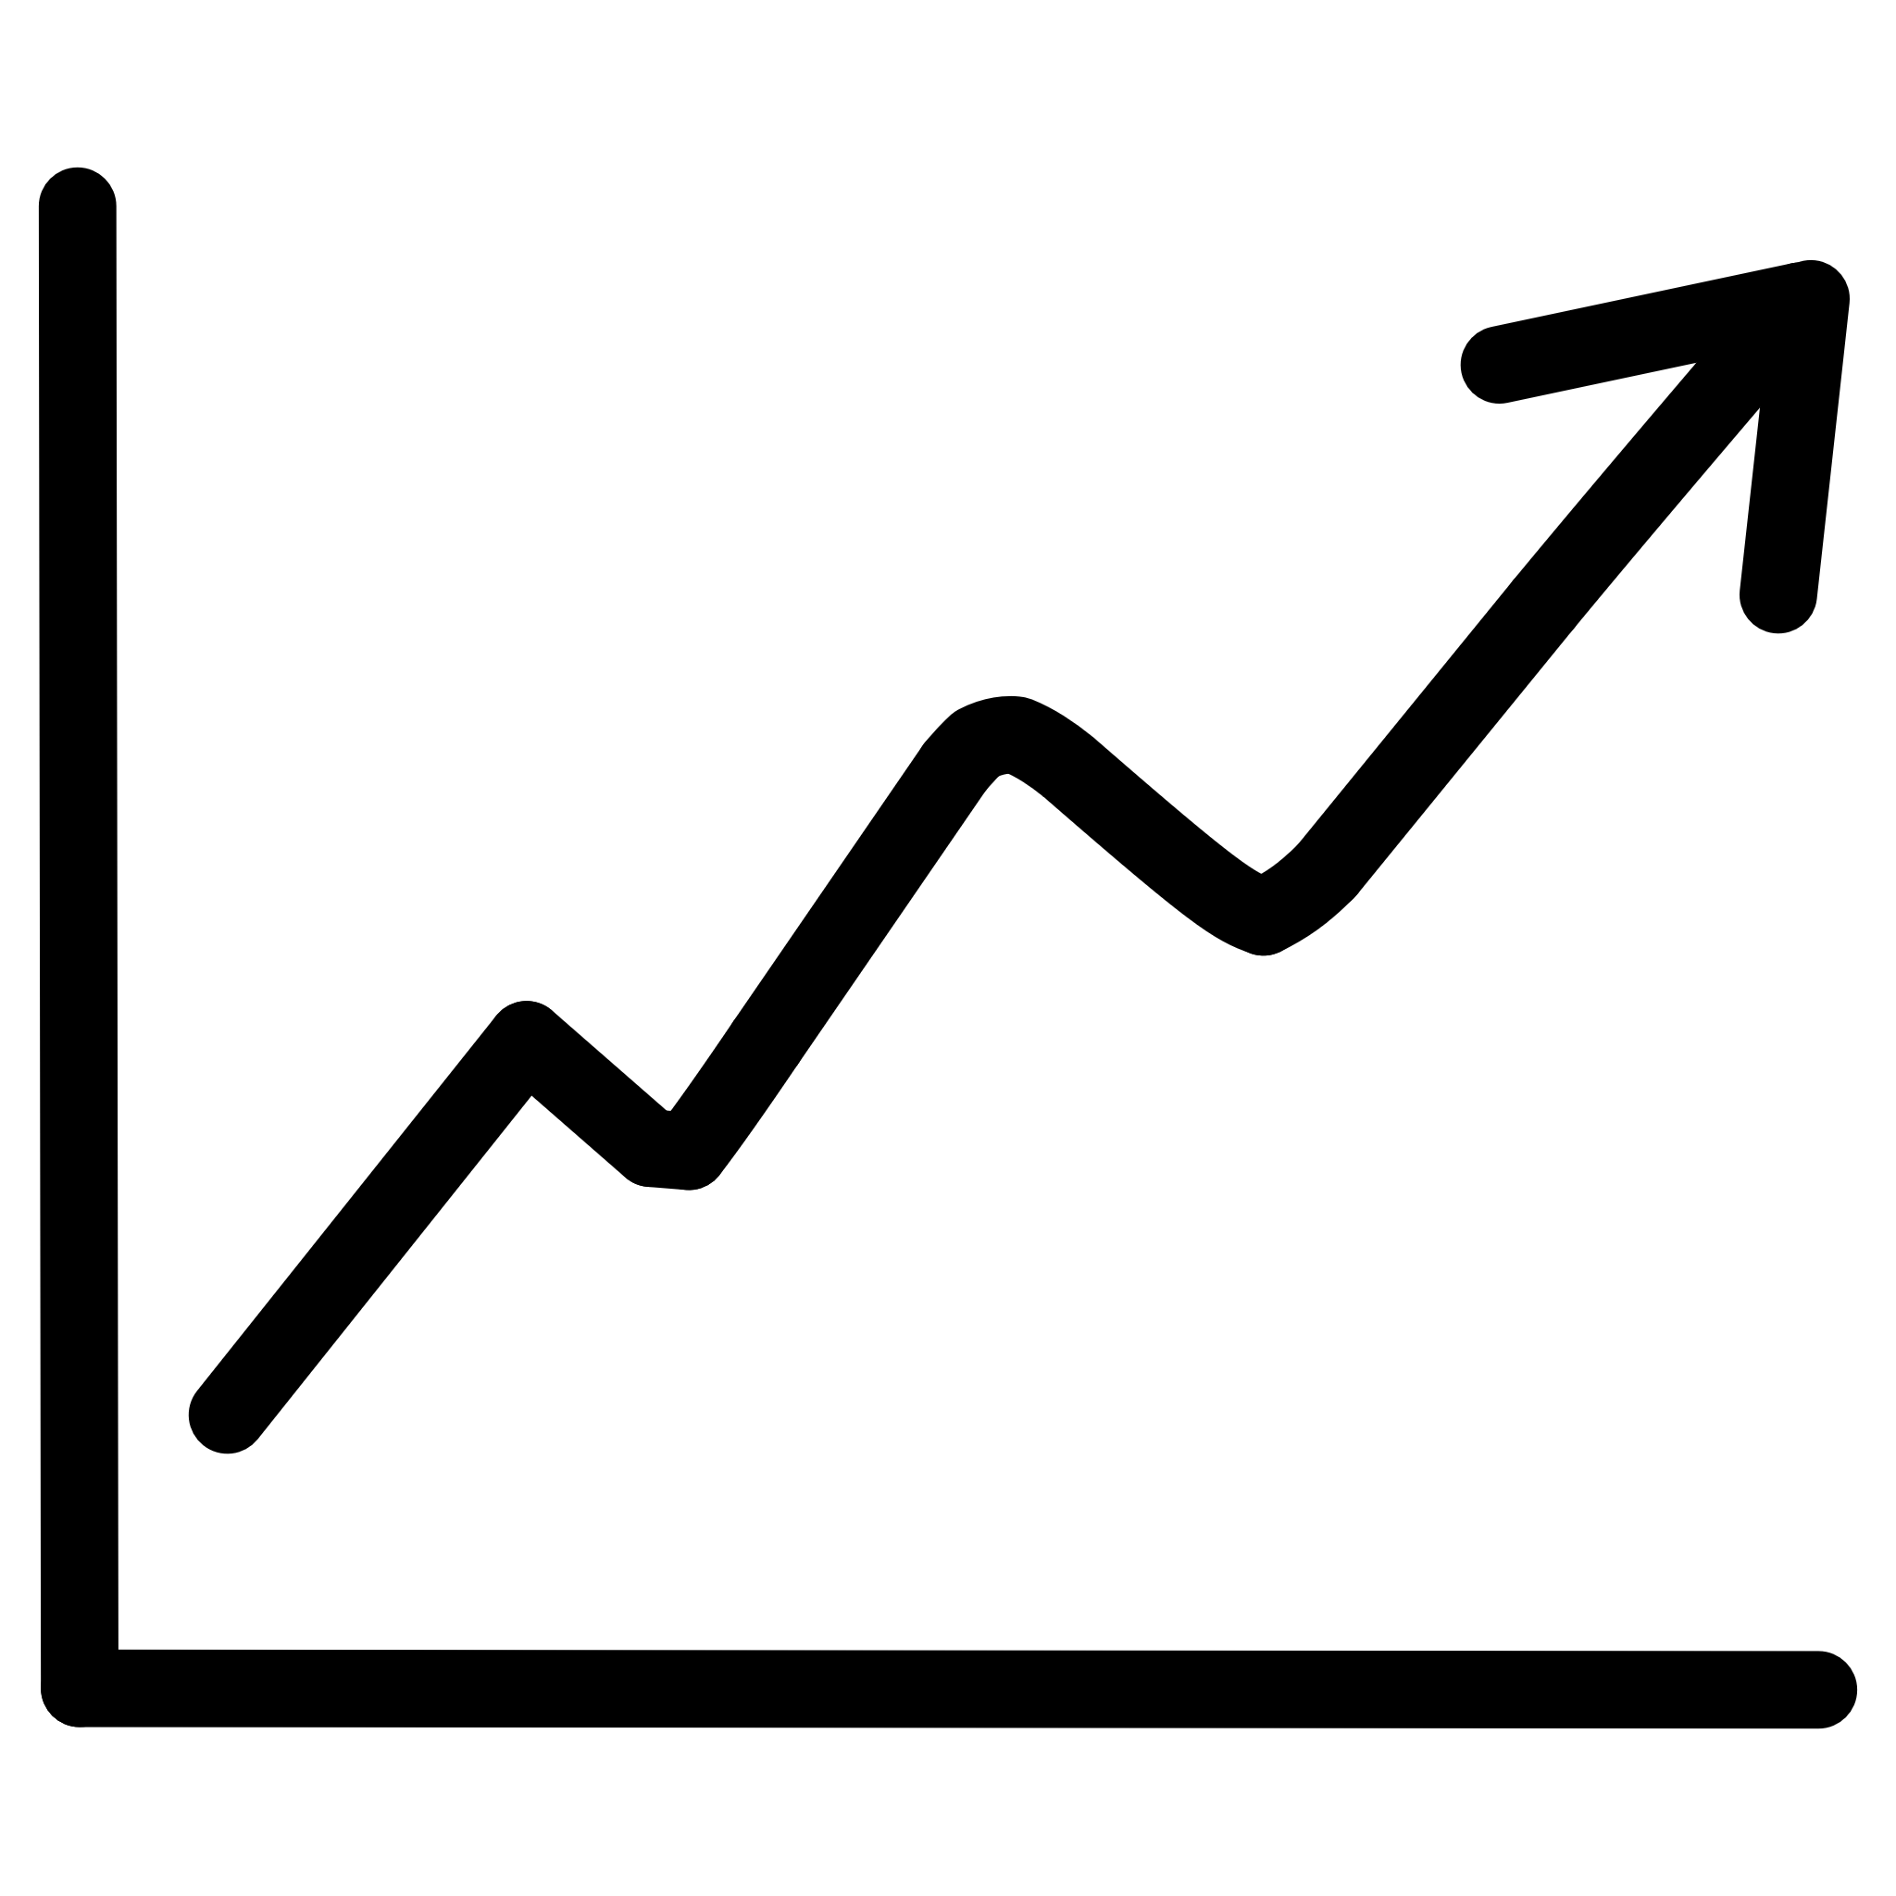

PROJECT OVERVIEW
Implementation Details
Key Features
Implementation of Distance Vector Routing Algorithm
Based on Bellman-Ford equation
Interactive GUI
Real-time routing table updates
Educational tool
Multiple network topologies
Link failure simulation
Convergence analysis
Step-by-step execution

Slide 3



KEY FEATURES
Interactive Network Builder
Real-Time Simulation
Multiple Topologies
Observe dynamic routing table updates live
Explore various pre-defined network structures
Drag-and-drop interface for easy setup
Visualize packet transmission paths
Import and export custom network configurations
Customize node properties and link costs
Simulate link failures and recoveries seamlessly
Analyze behavior across different network scales
Design unique network topologies effortlessly

Slide 4
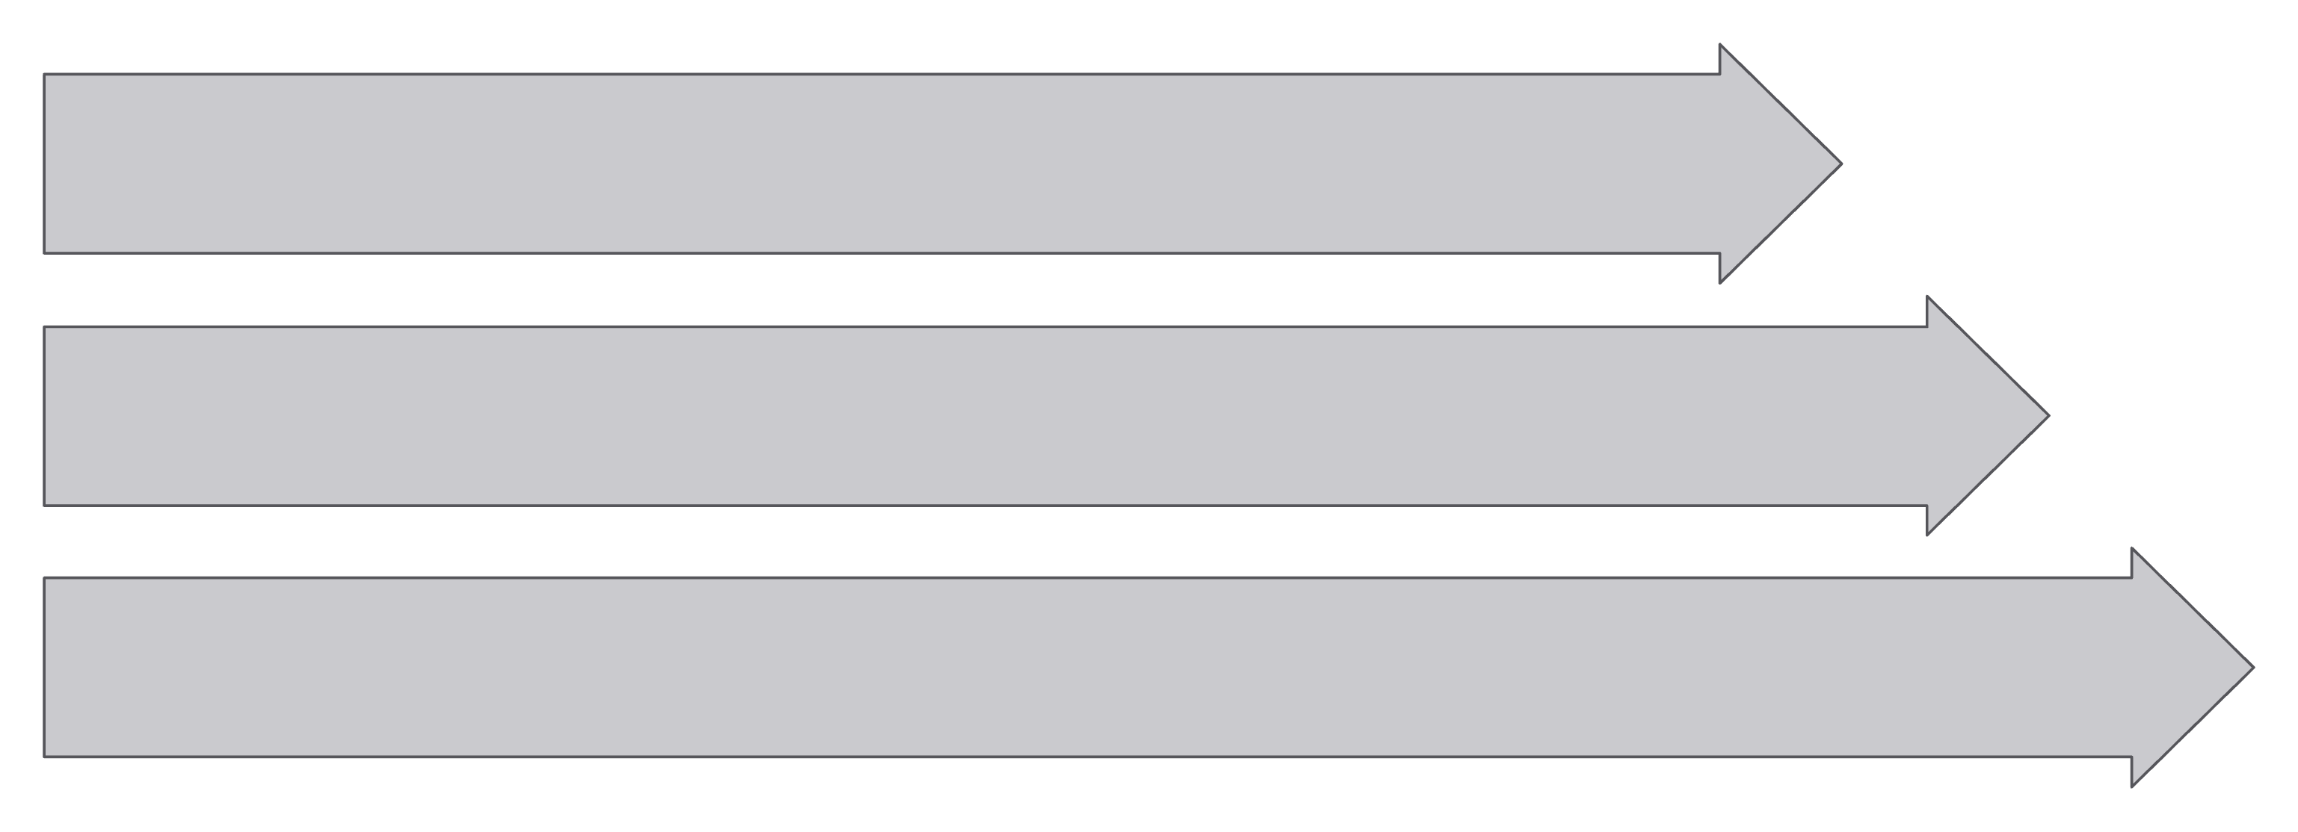
SYSTEM ARCHITECTURE
The simulator's architecture is structured into distinct layers, ensuring modularity and clear separation of concerns, facilitating both development and educational insights into the Distance Vector Routing Protocol.
GUI Layer
Simulation Engine
Network Model

Slide 5




TECHNICAL IMPLEMENTATION
Development Stack
Engineering Principles
Programming Language: Python 3.8+
Core Libraries:
Tkinter: For building the interactive GUI
NetworkX: Graph creation and manipulation for network topologies
Modular Design
Matplotlib: For visualizing convergence analysis
Independent components for ease of maintenance and future scalability.
Key Data Structures:
Dictionary: Efficient storage and lookup for routing tables
Adjacency List: Representing network topology and connections
Queue: Handling event scheduling and packet processing
Well-Documented
Clear inline comments and comprehensive documentation for code clarity.
Rigorously Tested
Unit and integration tests to ensure algorithm correctness and reliability.
Organized Hierarchy
Logical file structure and separation of concerns for easy navigation.

Slide 6




ALGORITHM IMPLEMENTATION
The simulator is built on a modular architecture, enabling clear separation of concerns and ease of understanding for educational purposes.
Router Class
Network Class
Models individual network nodes, maintaining routing tables and forwarding decisions.
Manages the entire network topology, including links, costs, and global state.
process_distance_vector()
Simulation Engine
GUI Visualizer
Orchestrates the simulation loop, applying routing updates and detecting convergence.
Provides an interactive graphical interface for real-time visualization of network changes.
execute_iteration()
get_shortest_path()
Each component works in conjunction to accurately simulate the dynamic behavior and intricacies of the Distance Vector Routing Protocol.

Slide 7
DISTANCE VECTOR ALGORITHM
The Distance Vector Algorithm is a distributed routing protocol where each router maintains a routing table and shares it with its directly connected neighbors. This process relies on the core principle of the Bellman-Ford equation to find the shortest paths to all other nodes in the network.
Where:
D_x(y) is the estimated cost from router x to destination y.
c(x,v) is the cost of the link from router x to its neighbor v.
D_v(y) is the estimated cost from neighbor v to destination y.
min_v indicates that router x chooses the neighbor v that offers the least total cost.
Key Principles
Distributed Algorithm: Each router works independently to calculate optimal paths.
Neighbor Information: Routers only share their routing tables with direct neighbors.
Independent Computation: Routers update their routing tables based on information from neighbors.
Basis for RIP: This algorithm forms the foundation for protocols like Routing Information Protocol.

Slide 8

LIVE DEMONSTRATION
Demo Steps
Expected Observations
Launch application
Create sample network
Tables populate gradually
Add routers
Create links
Run simulation
Optimal paths emerge
Observe updates
Simulate link failure
Convergence behavior visible

Slide 9
APPLICATION INTERFACE
Our simulator features an intuitive graphical user interface (GUI) designed for ease of use and effective learning.
GUI Components
Network Setup Tab
Configure nodes, links, and initial costs.
Simulation Control
Start, pause, and step through simulation events.
Routing Tables Tab
User Workflow
View real-time updates of each node's routing table.
01
Build Network Topology: Define nodes and links to create a custom network.
Simulation Log
02
Run Simulation: Execute the Distance Vector Algorithm step-by-step or continuously.
Track all events, message exchanges, and convergence status.
03
Analyze Convergence: Evaluate algorithm performance and identify stable states.
04
Observe Table Updates: Monitor how routing tables converge over time.

Slide 10
CONVERGENCE ANALYSIS
Understanding how the Distance Vector Routing Protocol reaches a stable state within the network.
Iteration 1
Initial State
Nodes update routing tables based on received information from neighbors.
Network nodes are initialized, exchanging first distance vectors.
Converged
Iteration 2
All routing tables stabilize, reflecting optimal paths and costs.
Further exchanges occur, refining paths and costs across the network.
Key convergence metrics:
Iterations to Stability: Typically O(N) in simple scenarios, where N is the number of nodes.
Message Complexity: Can reach O(N²) in complex topologies, due to iterative updates.
Update Frequency: Decreases as the network approaches a stable state.

Slide 11
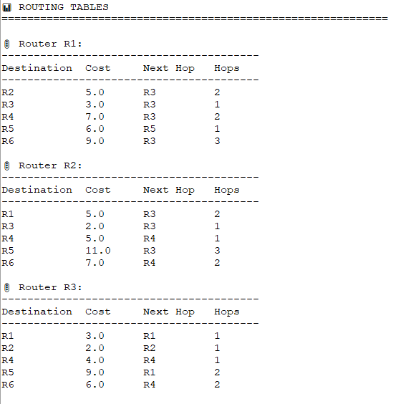
ROUTING TABLES IN ACTION
Let's examine how routing tables are built and maintained in a simple network scenario using the Distance Vector Routing Protocol.
Each router (node) in the network maintains its own routing table, which contains the best-known path to every other destination, along with the associated cost and the next hop to reach it. These tables are updated by exchanging information with directly connected neighbors.

Slide 12
LIMITATIONS & CHALLENGES
While effective in smaller, stable networks, Distance Vector Routing Protocols face inherent challenges that can impact network performance and reliability.
Count-to-Infinity Problem
Slow Convergence
Suboptimal Paths
Routing loops can form, causing routers to continuously increment hop counts for unreachable destinations, leading to network instability and incorrect distance metrics.
The algorithm can be slow to adapt to network topology changes, especially when a link fails. "Bad news" propagates slowly through the network, prolonging routing inaccuracies.
Due to its reliance on local information and incremental updates, DVRP may occasionally converge on paths that are not truly optimal, leading to less efficient data transmission.

Slide 13
EDUCATIONAL SIGNIFICANCE
Learning Objectives
Academic Applications
1
Understand distributed routing principles
Computer Networks Courses
2
Hands-on exploration of routing protocols and network fundamentals.
Visualize algorithm execution dynamically
3
Analyze convergence behavior and stability
Distributed Systems
Illustrating inter-process communication and state synchronization.
4
Experiment with diverse network topologies
Algorithm Visualization Labs
5
Identify protocol limitations and solutions
Practical application of graph theory and dynamic programming.
Protocol Design & Analysis
Foundational understanding for advanced research and development.

Slide 14

RESULTS & ACHIEVEMENTS
Successfully Implemented
Key Insights
Distributed algorithms are powerful: Demonstrated the efficiency of decentralized routing decisions.
Complete Distance Vector Algorithm
Visualization aids understanding: Real-time updates significantly improve learning complex concepts.
Interactive Graphical User Interface (GUI)
Support for Multiple Network Topologies
Real-world protocols balance trade-offs: Highlighted the practical challenges and compromises in network design.
Designed as an Educational Tool
Network topology affects performance: Directly observed how different network structures impact convergence and stability.
Measurement of Key Performance Metrics

Slide 15
FUTURE EXTENSIONS
Potential Improvements
Research Applications
Web-based Interface: Develop a user-friendly web application for remote access and broader accessibility.
Protocol Comparison: Facilitate detailed comparative analysis of different routing protocols under various network conditions.
Additional Protocols: Integrate advanced routing protocols such as OSPF and BGP for comprehensive network simulation.
Convergence Optimization: Provide tools for researching and optimizing network convergence times and stability metrics.
Real-time Collaboration: Enable multiple users to collaborate on network design and simulation in real-time.
Fault Tolerance Analysis: Evaluate network resilience and fault tolerance mechanisms against diverse failure scenarios.
Mobile Ad-Hoc Support: Add capabilities to simulate Mobile Ad-Hoc Networks (MANETs) and their unique routing challenges.
SDN Integration: Explore the performance and implications of integrating Software-Defined Networking (SDN) architectures.
Real Network Integration: Allow the simulator to connect with live network data for more realistic scenario testing and analysis.

Slide 16




CONCLUSION
This project has successfully demonstrated the principles of Distance Vector Routing, providing a robust platform for both implementation and learning.
Project Success
Complete Implementation
Educational Tool
Fully functional Python simulation of the Distance Vector algorithm.
An intuitive GUI to visualize complex routing concepts.
Distributed Systems Concepts
Foundation for Studies
Clear demonstration of Bellman-Ford equation and convergence.
A strong base for exploring advanced network protocols.
Key Takeaways
Distance Vector is Fundamental
Visualization Enhances Learning
Understanding its mechanics is crucial for network professionals.
Interactive tools make abstract algorithms tangible.
Distributed Algorithms Have Challenges
Real-World Protocols Balance Trade-offs
Convergence issues and count-to-infinity are critical considerations.
Efficiency, stability, and overhead are key design factors.
THANK YOU!
Questions & Discussion

